Slide 1
Curriculum is… Nahachewsky Edci 532

Slide 2
Some questions…
Is curriculum an object, an intention, an action…?
Should curriculum be about self, society or something else?
Who creates curriculum?

Slide 3
Curriculum is...
“defined broadly as any complex structure, or set of structures, that supports learning and teaching”.
(Canadian Association for Curriculum Studies, 2020)

Slide 4
Egan (2003, 1978, 2020) and Blades (1995, 2015, 2017) have both troubled and reinforced certain narratives and conceptions of curricular D/discourse and development as interaction of what, how, and who over time.

Slide 5
Curriculum
… often refers specifically to a planned sequence of instruction, or to a view of the student’s experiences in terms of the educator’s or schools instructional goals.

Slide 6
The Progressive period (1900 – 1949) emerging from the Victorian and American sense of Progressivism (Egan called this “bourgeois confidence and optimism that was embodied in the 19th century revolutions – technological, aesthetic, intellectual, and political) with theorists such as Dewey, Montessori, and Bobbitt who were impacted by social events such as mass immigration, urbanization, mechanization, world wars, economic depression and the suffragette movement. The main tensions between “what we teach” and “how we teach” are manifested through these thinkers.

Slide 7
Curriculum…
may be highly standardized, or include varying levels of instructor and/or learner autonomy.

Slide 8
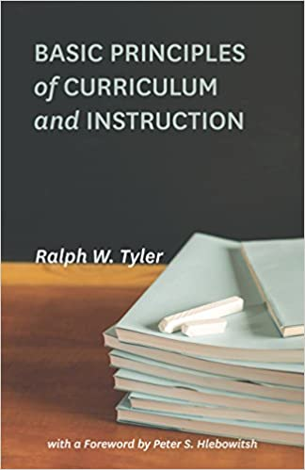
A major work in curriculum development/theorizing is published in 1949. It culminates the above period and bridges to the period below – it is Tyler’s (1949) Basic Principles of Curriculum and Instruction.

Slide 9
Tyler Rationale (1949)
What educational purposes should the school seek to attain? (Defining appropriate societal/school learning objectives. Outcomes and competencies)
How can learning experiences be selected which are likely to be useful in attaining these objectives? (Introducing useful learning experiences – “TSWBAT”)
How can learning experiences be organized for effective instruction? (Organizing experiences to maximize their effect. Strategies)
How can the effectiveness of learning experiences be evaluated? (Evaluating the process and revising the areas that were not effective. Assessment of learning)

Slide 10
Much of the discourse about, and enaction of curriculum development – throughout the the reform and reconceptualist periods - have been in response to Tyler’s rationale
(Wraga, 2017)

Slide 11
The Reform movement (1950 – 1969) includes educators and theorists such as Bruner and Popham (both of whom we’ll read next week). This was a period heavily influenced by modernism, the Cold War, the space race and it generated a time of curricular development/theorizing that focused on behaviourism, domains, objectives, assessment, and scientific approaches.

Slide 12
The Reconceptualists (1970 – 1990s) a time of experimentation and radicalism with more attention paid to individual learners and their needs (ontology and epistemology) through critical pedagogy, emancipatory education, transformative education, and feminism by theorists such as Apple, Freire, Greene

Slide 13
Curriculum
…can be split into several categories: the explicit, the implicit (including the hidden), the excluded, and the extracurricular

Slide 14
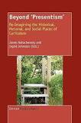
In medias res (2000s - present ) This is our contemporary times, so we are in the ‘midst of its story’. Curriculum development and theorizing in Canada is impacted by globalism, neoliberalism, multiculturalism, indigeneity, decolonization, ecology, queer theory (amongst many others), and for our purposes – the digital world.

Slide 15
What happens to curricula when social and personal trends such as digitization emerge?
How should curriculum respond to personal and social experiences such as the need for decolonization?

