Slide 1
Accessibility, Universal Design for Learning (UDL)
Josie Gray
Advisor, Inclusive Design and OER Collections
BCcampus
jgray@bccampus.ca
Notes:
Hello everyone, thank you for having me here today. My name is Josie Gray.
I am joining you from Victoria, B.C., which is the traditional and unceded territories of the Lkwungen-speaking peoples, now known as the Esquimalt and Songhees Nations, and the territory of the WSANEC Peoples. I am a white settler and have lived here uninvited on these territories for 7 years. This is where I completed my undergraduate degree and where I now do my work for BCcampus, and I am very grateful and privileged to be able to live here. I grew up on unceeded Tshimsian territory on the north west coast, and I also have ties to Treaty 6 territory in central Alberta, where my extended family lives and where I spent a lot of time growing up. I am very grateful for the opportunities I have had to learn and grow on each of these territories
I work for BCcampus, which is an organization funded by the Ministry of Advanced Education to support all public post-secondary institutions in BC in the areas of Teaching and Learning, educational technology, and open education. I’ve been at BCcampus for four years, and in that time, I have done a lot of work around accessibility, inclusive design, and universal design for learning in the context of open educational resources. Open educational resources, or OER, are any type of resource that may be used for teaching and learning – such as a textbook, video, or exam questions – that are under an open licence that allows others to use those materials for free and make edits to them. So another part of my job is maintaining the BC Open Textbook Collection, which contains over 300 free, digital textbooks for post-secondary.
I am currently in my second year of my Masters in Inclusive Design at OCAD University in Toronto, where my research focuses on epistemic injustice in open educational resources.
So I have a short presentation prepared on accessibility and universal design for learning. Please take note of any questions you have during the presentation because I would love to discuss them after.

Slide 2
What is disability?
Notes:
I wanted to start off with this question, “What is disability?” When talking about accessibility, it is helpful to talk a bit about how we think about disability and how that affects our understanding of and approach to the work of making education accessible.

Slide 3
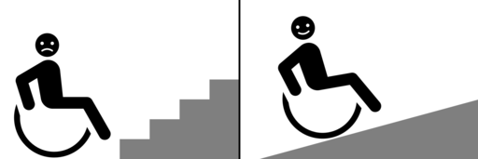
Individual model vs. social model of disability
Image: “Social Model of Disability” by MissLunaRose12 is under a CC BY 4.0 Licence.
Notes:
There are two ways we can understand disability: The individual model or the social model.
The individual model of disability “understands disability as an individual problem, affliction, or deficit that needs a cure or accommodation.” It sees disability as an individual trait. This is the model that is used in medical settings, and it is also used at universities and colleges where students need to have a diagnosed disability to be eligible for accommodation. This model groups people into categories. Either you are disabled, and eligible for accommodation. Or you are not. This approach leaves a lot of people out, and it puts the onus on individuals to advocate for themselves to get the accommodations they need.
In contrast, there is the social model of disability, which looks at how the design of things outside of a person and society as a whole can create disability. For example, a person in a wheelchair experiences disability when a restaurant has a stairs-only entrance. However, if those stairs were a ramp, that barrier would disappear, and their wheelchair would no longer be a problem. Similarly, a blind student experiences disability when their textbook is only available in a print format. However, if that resource was designed to be read with a screen reader or translated into Braille, that barrier would disappear.

Slide 4

Disability as
a mismatch.
Image: "Doesn't Fit" by Maestrosphere is under a Pixabay licence. Cropped by Josie Gray.
Notes:
As such, it is better to understand disability as emerging when there is a mismatch between a person, their environment, and the tools they have available to them.
With this model, the onus is on the environment to be designed to be accessible, rather than on the individual to adapt to the environment or request an accommodation.
The social model of disability complicates the binary categories of disabled vs abled. Instead, disability becomes more of a spectrum that can affect different people in different ways depending on their context, environment, and the tools they have access to, and is a product of history and culture. To go back to the ramp example, a lot of people benefit from ramps. This includes people on crutches, young children, or someone with a rolly suitcase.
The social model of disability encourages us to use accessible design to create more accessible experiences from the very beginning, rather than trying to accommodate after. And this aligns very well with universal design for learning, which I will talk about more in a few minutes.
So in the context of education, one way of doing this is by creating and using accessible educational materials. Not only does this make these resources more useful and flexible for all students, but it ensures disabled students have access to the same content at the same time as their peers, without needing to request accommodation.

Slide 5
What affects access to learning?
Presentation, format, and structure of information
Day-to-day life and personal responsibilities
Access to technology and Internet
Unfamiliar or complex technology
Notes:
Lots of things affect access to learning, even for students that don’t identify as disabled.
For example, the presentation, format, and structure of information can increase or impede access.
In addition, day-to-day life and personal responsibilities can impede access. Examples of this might include needing to spend long hours on transit to get to work, which makes it difficult to get readings done. If those readings are in a format that can be downloaded on a phone, all of a sudden that reading becomes a lot easier to complete. Busy work schedules or caregiving responsibilities can impact a person’s ability to attend synchronous sessions.
Access to technology and Internet are important things to consider, especially in the context of online education. Not all students have reliable internet access at home or a personal device. For these students, low bandwidth, downloadable options may be necessary.
And finally, unfamiliar or complex technology can create barriers. It’s really hard to learn from something you can’t figure out how to use or navigate.

Slide 6
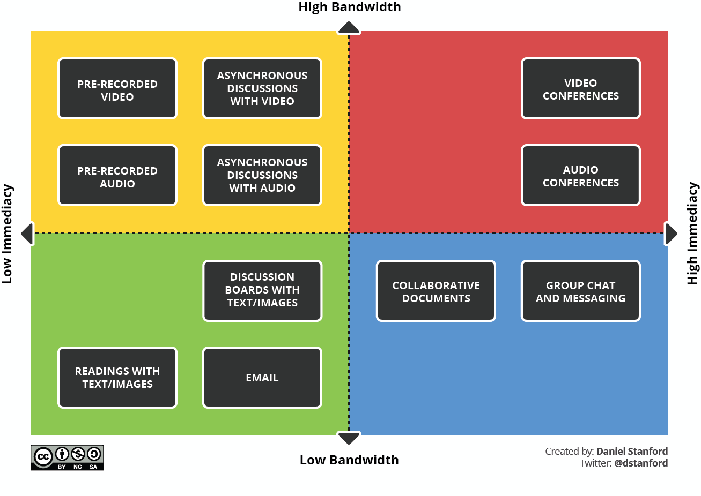
“Videoconferencing Alternatives: How Low-Bandwidth Teaching Will Save Us All” by Daniel Standford. CC BY-NC-SA.
Notes:
On the topic of access to internet, I wanted to share this graphic.
With the pandemic and a rapid shift to online, there's been a lot of discussion about equity issues in the context of online education. So on the slide here I have a graphic that was created by Daniel Stanford, which compares teaching strategies based on the level of bandwidth required and the immediacy of the activity, meaning whether or not it is something that people can do on their own time.
So this graphic uses an X&Y axis to divide up these different teaching strategies. On the X axis is low to high immediacy and on the Y axis it's low bandwidth to high bandwidth. So I will go through each of these quadrants.
On the top right, which is high bandwidth and high immediacy, there is live video conference or audio conference like we're doing right now.
On the top left there is high bandwidth but low immediacy, which includes pre-recorded video or audio and asynchronous discussions with video or audio.
On the bottom right there is high immediacy but low bandwidth, which would be things like collaborative documents or group chat and messaging.
And then finally, on the bottom left there is low immediacy and low bandwidth. So examples of these are discussion boards with text and images, email, and then readings with text and images.
From my perspective, the point of this graphic is to convey the choice and flexibility that exists in online environments.

Slide 7
Accessibility vs. Universal Design for Learning (UDL)
Notes:
So I'm going to be talking about the role that Accessibility and Universal Design for Learning play to make education more inclusive and equitable. These two concepts are compatible, but not the same. For example, a class can be designed to be accessible without incorporating UDL and vice versa.

Slide 8
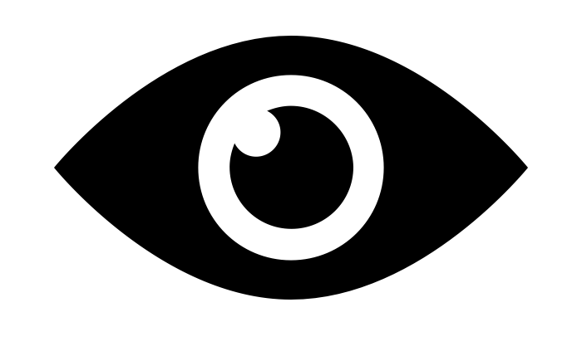
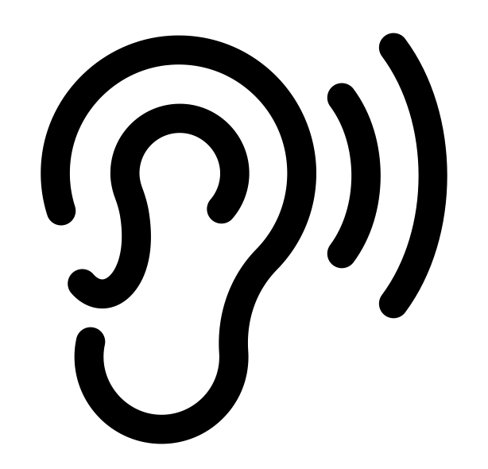


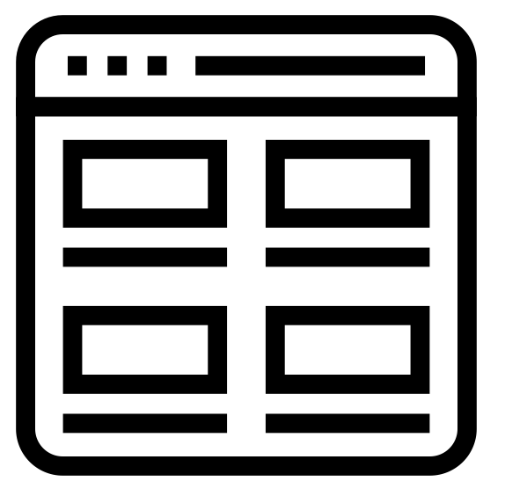

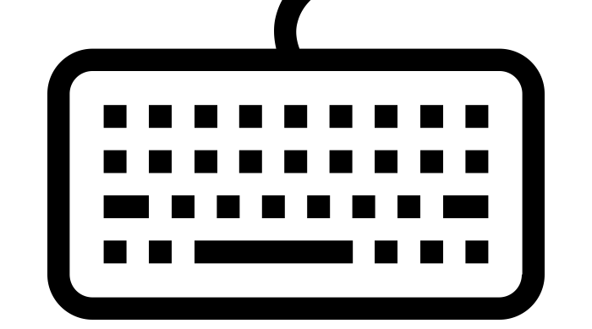



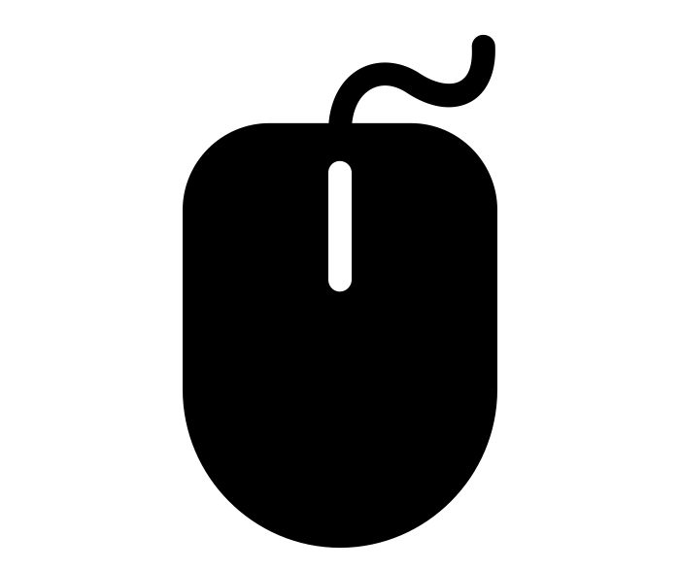

Web Content Accessibility Guidelines (WCAG)
Perceivable
Operable
Understandable
Robust
Notes:
In the context of online education and education that leverages digital tools and platforms, the Web Content Accessibility Guidelines (WCAG) are really important. The WCAG is an international digital accessibility standard that is developed and maintained by the W3C Web Accessibility Initiative and adopted all over the world. The WCAG was created specifically to ensure that disabled people have equal access to web content. However, these accessibility guidelines benefit everyone.
WCAG has four main principles: perceivable, operable, understandable, and robust.
Perceivable focuses on the ability for all students to perceive something through one of their senses. This means the information needs to be available through sight, sound, and touch, or available in such a way that assistive technology could be used to translate that content for another sense. An example of this is captions on a video for someone who can’t hear the audio or text descriptions of images that can be read aloud for someone who can’t see the image.
Operable focuses how people can navigate and interact with the resource or digital platform. For example, someone should be able to navigate through a resource using only their keyboard. Navigation should be easy and make sense.
The Understandable principle requires that information and the operation of the user interface must be understandable. That means the text is readable and understandable and the layout of a page is predictable and consistent.
And finally, robust requires that digital resources and platforms are able to be used on a variety of devices, browsers, and with various assistive technologies. So for example, a website should not only work on Google Chrome or on a computer.
The web content accessibility guidelines provide a collection of success criteria under each of the principles that are a lot more specific, and we can come back to this later In the discussion if people are interested in diving more into the specifics.
But the main takeaway here is that these web content accessibility guidelines are highly relevant in online education. It applies to the design of educational materials like textbooks, readings, or videos, also educational experiences like lectures or discussions, and also the kind of tools that are being used in the classroom, so the learning management system, the video conferencing software, the polling tools, etc.

Slide 9
Accessible design
Text (Headings, font)
Links
Images
Colour
Video
Audio
Math
Links

Slide 10
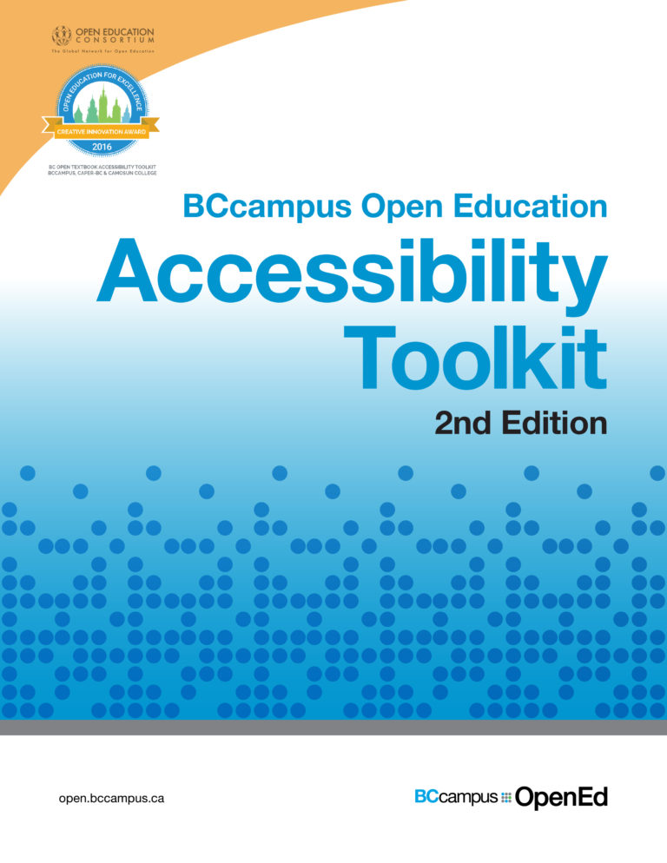
More information: Accessibility Toolkit
Find: OpenTextBC.ca/AccessibilityToolkit/
Covers how to create accessible digital educational materials with a specific focus on:
Text (Headings, font)
Links
Images
Colour
Video
Audio
Math
Links
Notes:
If you're looking for more concrete information about how to create accessible educational materials, a resource I would recommend is the Accessibility Toolkit, which you can access at opentextbc.ca/AccessibilityToolkit this resource focuses on open educational materials but the information in it can really be general generalized to anything, whether you're writing a blog post or creating in Microsoft Word. Basically it will provide step by step instructions for making different types of educational resources accessible, including a specific focus on text, links, images, colour, video, audio, math, and links.

Slide 11
Universal Design for Learning (UDL)
A framework for course design that aims to give all students equal opportunities to learn.
It takes a one-size-fits-one approach: Providing students with flexibility to be able to move through a course based on their needs, context, and interests.
Notes:
So now I'll talk a little bit about universal design for learning or UDL. UDL is a framework for course design that aims to give all students equal opportunities to learn.
It does that by taking one-size-fits-one approach. It assumes that students are different and that you can't treat all students the same and expect them all to succeed and learn. So instead, UDL aims to provide students with flexibility to be able to move through the course based on their needs context and interests.

Slide 12



Three Principles of UDL
Provide multiple means of..
Engagement – motivation to learn and persist
Representation – how students consume and organize information
Action and expression – how students demonstrate learning
Brain icons by CAST. CC BY-SA.
Notes:
UDL is broken up into three principles.
The first principle is to provide multiple means of engagement, which basically relates to providing different opportunities and choices to motivate students to learn and persist through a course.
The second principle is to provide multiple means of representation, which relates to providing students multiple options over how they consume and organize information. So for example that could mean providing students a choice between reading an article or watching a video.
And finally, provide multiple means of action an expression, which means to give students flexibility and choice in how they demonstrate their learning. For example, maybe one student wants to write an essay while another wants to do a class presentation.
And the reason I have small images of the human brain with different regions highlighted is because UDL is guided by research in the brain and how we learn. As such, each of these principles align with a neuro network.

Slide 13
Benefits of UDL
Reduces the need for individual accommodation
Increases flexibility and options for all students
Helps focus attention of specific course learning outcomes
Notes:
UDL has a number of potential benefits.
It has the potential to reduce the need for individual accommodation.
It can increase flexibility and options for all students
and it helps focus attention on specific course learning outcomes, which I'll talk more about in a few minutes

Slide 14
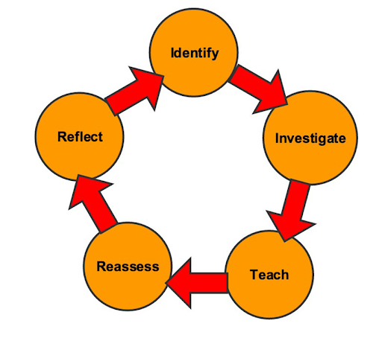
UDL is a process and a practice – not a checklist
Reflect: What are students struggling with?
Identify: What UDL principle or checkpoint would address this?
Investigate: How could you incorporate UDL here?
Teach: Put that new strategy into practice.
Assess: How did that strategy work?
Reflect: Did the new method or strategy have the desired effect?
“Process for getting started” graphic by CAST based on Nelson (20140). CC BY-SA.
Notes:
UDL is an iterative practice. It’s not really something that is completed or can be checked off or perfected.
On the slides I have a cyclical diagram that represents the process of getting started with UDL.
It starts with reflection…

Slide 15
Separate means from ends in learning goals
Learning goals should focus on the desired outcomes rather than how to demonstrate those outcomes
Provides “multiple pathways” for achievement
Example: A learning goal in a human anatomy class
Write a paragraph about how the circulatory system works.
Vs.
Describe how the circulatory system works.
Notes:
One thing that UDL encourages is for instructors to separate the means from ends in learning goals.
So what this means is that learning goals should focus on the desired outcomes rather than how to demonstrate those outcomes, which makes it easier to provide multiple pathways for achievement.
For example, a learning goal in a human anatomy class might be, “Write a paragraph about how the circulatory system works.” In this case, “write a paragraph” has been made part of the learning goal. However, the learning goal could just be, “Describe how the circulatory system works.” This would give more flexibility in how students can show that they understand the circulatory system.

Slide 16
Construct relevance in assessments
Construct: the knowledge, skills, or abilities being measured by an assessment
How can you make sure an assessment is designed to only evaluate constructs that are relevant to the learning goals of the course?
Notes:
This is related to this idea of construct relevance in assessment.
A “construct” in in this context is the knowledge, skills, or abilities being measured by an assessment.
How can you make sure an assessment is designed to only evaluate constructs that are relevant to the learning goals of the course

Slide 17
Examples of “construct irrelevant” aspects of assessments
Example 1
A math assessment that includes word problems to assess a students’ understanding of math concepts
Construct irrelevant aspects include:
Ability to read fluently
Example 2
A History class with a timed and closed booked exam with essay questions.
Construct irrelevant aspects include:
Ability to work under pressure
Motor coordination (handwriting/typing)
Short-term and working memory
Attention span
Text content adapted from “UDL and Assessment” by CAST. CC BY-SA.
Notes:
This is where having clear learning goals is really important. Here are two examples of assessments that have construct irrelevant aspects.
The first example is a math assessment that includes word problems to assess students’ understanding of math concepts .Iin this case, a construct irrelevant aspect of this assessment is the ability to read well. Just because a student struggles with reading comprehension does not mean that they don't understand the math concepts.
[Advance slide]
A second example is a history class that has a timed, closed book final exam with essay questions. In this case, construct irrelevant aspects of this assessment include the ability to work under pressure, motor coordination such as handwriting and typing, short term and working memory, and attention span. If a student struggles with any of these four things, they're going to have a much harder time been successful in the exam. This is a problem if the goal of the exam is to test a student’s ability to craft a well-structured historical argument.
The goal of removing contract irrelevant assessment strategies is not to lessen the rigor of the assessment. Instead, the goal is get a more accurate representation of the specific skills and knowledge that need to be assessed.
By going back to the learning goals, you can determine if a timed, closed book exam is necessary is the best way to test the ability to craft a historical argument.
In regards, to the math assessment, providing an audio version of questions or access to text to speech tools ensures that students don’t have to rely on their reading ability to answer the question.

